Slide 1

YOLO : Real-time object detection
Advisor：Jenq-Shiou Leu
Student：Raymond
Date：2017/09/28
National Taiwan University of Science and Technology

Slide 2
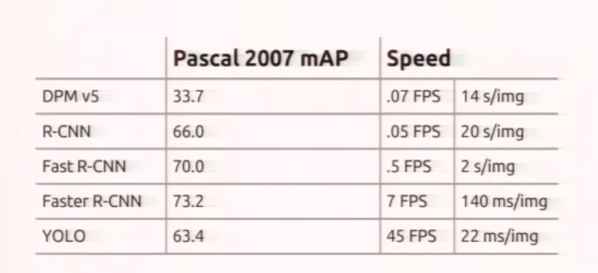
Objection detection is slow

Slide 3
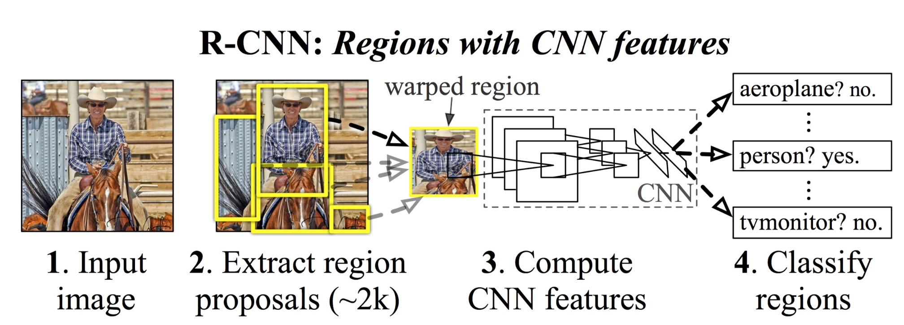
Region Based Proposal

Slide 4
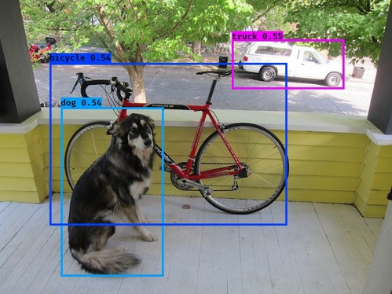
YOLO Introduction
You Only Look Once
Avoid the redundant computation

Slide 5
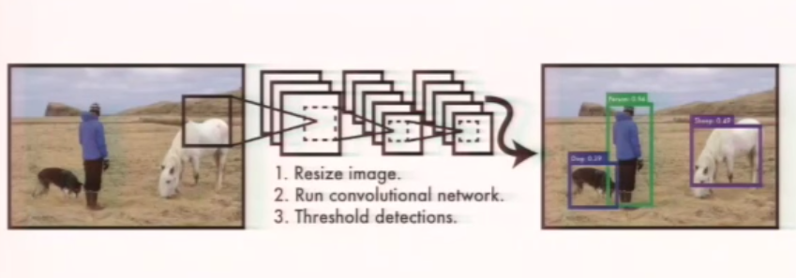

Slide 6
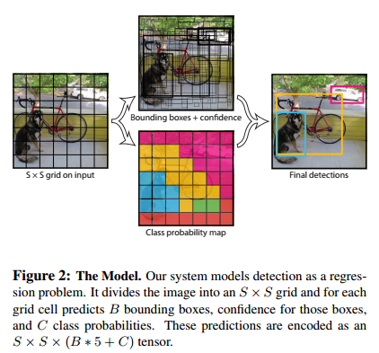
Bounding box : confidence
Cell : class probability

Slide 7
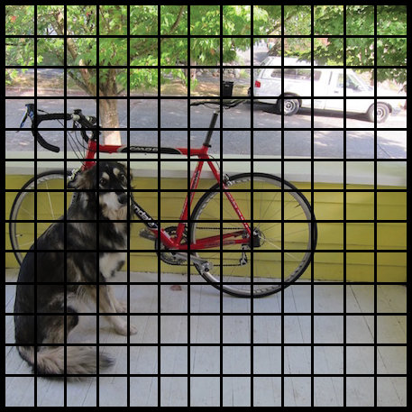
Unified Detection
Divide image into 13 X 13 cells
Each cell is responsible for predicting 5 bounding boxes
5 parameters for a bounding box
x，y，w，h，confidence
（x，y）central of box
（w，h）width and height of box
confidence IOU of boxes and ground truth
Notes:
該神經網絡採用整個圖像信息來預測目標的bounding boxes的同時識別目標的類別，實現端到端實時目標檢測任務

Slide 8
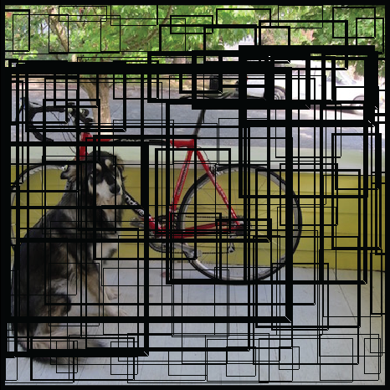
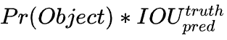
C（ ）
confidence score that tells us how certain it is that the predicted bounding box actually encloses some object
(1) Pr(Object)
= 1 if ground truth in the cell, other =0
(2) IOU
Intersection between ground truth and prediction

Slide 9
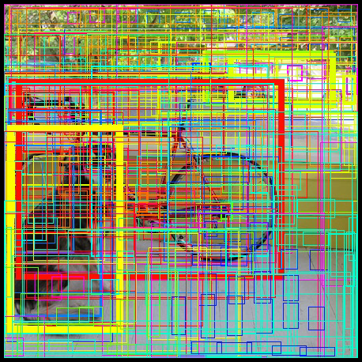
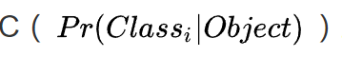
class probability is a conditional probabilities tell us how certain this cell belongs to a class

Slide 10
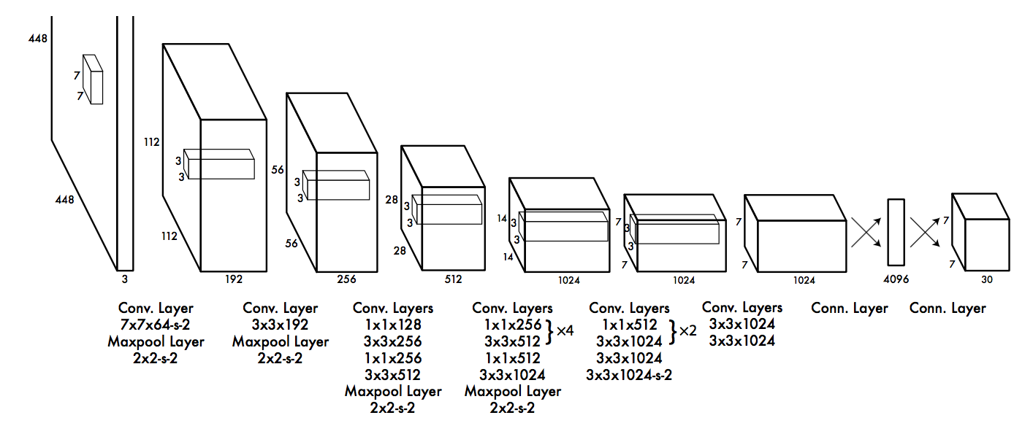
Notes:
Inspired by GoogLeNet

Slide 11
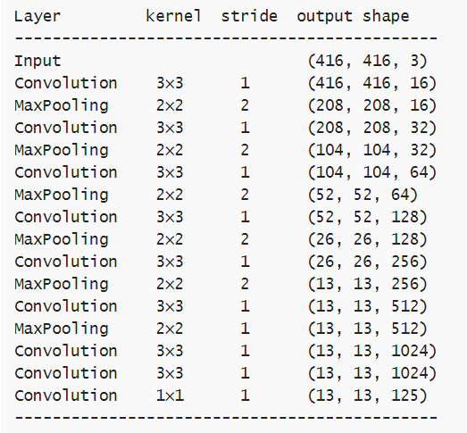
Fully Convolutional Network
Filter 3×3
Max pooling 2×2
Tiny YOLO只有這9個卷積層和6個池層
YOLOv2模型使用了三倍的層數

Slide 12
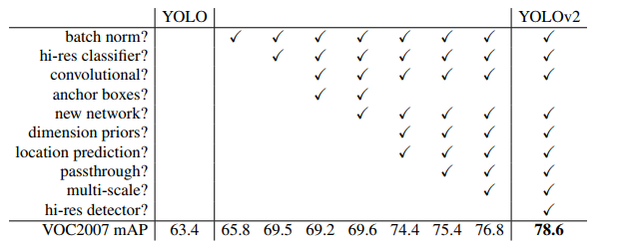
YOLO v2 Skill
Better，Faster，Stronger
Batch Normalization
High Resolution Classifier
Convolutional With Anchor Boxes
Fine-Grained Features
Multi-Scale Training

Slide 13
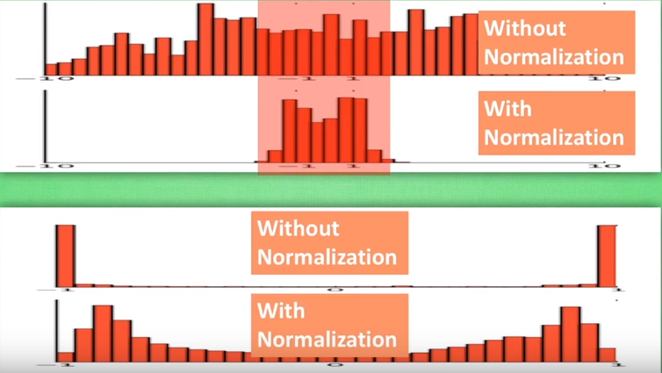
Batch Normalization
Normalization
Back-forward from Hidden layer
Add BN between a conv layer
and activate layer
Increase 2% mAP
Notes:
收敛速度很慢
提高模型精度

Slide 14
High Resolution Classifier
First use 448×448 res for input
Increase 4% mAP

Slide 15
Convolutional With Anchor Boxes
How to predict bounding box
YOLO – fully connected layer – 98 boxes (7X7X2)
Faster R-CNN – hand picked (use cnn to prdict confidence and shift)
V2 – more than 1000 boxes
Statics
YOLO : 69.5mAP with 81% recall
V2 : 69.2mAP with 88% recall

Slide 16
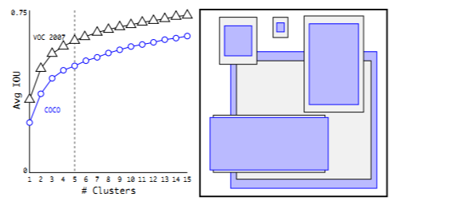
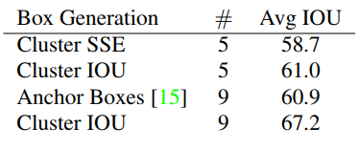
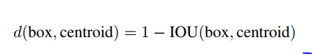
Dimension Clusters
Problem of anchor boxes
Hand picked and prediction
Use k-mean to choose the initial
location of the bounding box
The average IOU of objects on VOC 2007

Slide 17
Direct location prediction
Model instability, especially during early iterations
x, y, w, h, confidence
Increase 5% mAP

Slide 18
Fine-Grained Features
Modified on feature map
26*26*512 -> 13*13*2048
The passthrough layer concatenates the higher resolution features with the low resolution features by stacking adjacent features into different channels instead of spatial locations
Increase 1% mAP
Notes:
Faster RCNN和SSD方法中使用多个不同feature map提高算法对不同分辨率目标物体的检测能力的启发，加入了一个pass-through层，直接将倒数第二层的26×26大小的feature map加进来。

Slide 19
Multi-Scale Training
Goal : Performance on different resolution
changed the resolution to 416×416
Can input any size of picture since contain conv and pooling layer
10 epoch randomly chooses a new image dimension size
Downsamples by a factor of 32 => {320, 352, ..., 608}

Slide 20
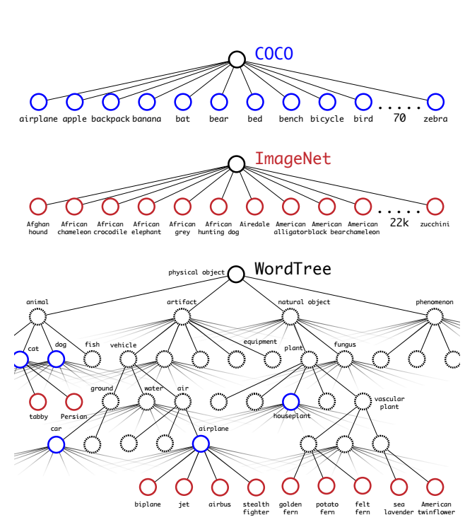
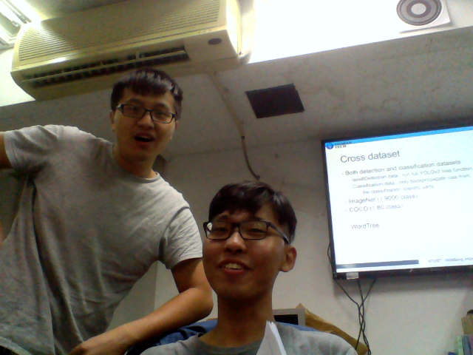
Cross dataset
Both detection and classification datasets
lassifiDetection data : run full YOLOv2 loss function
Classification data : only backpropagate loss from
the classification specific parts
ImageNet (↑ 9000 class)
COCO (↑ 80 class)
WordTree

Slide 21
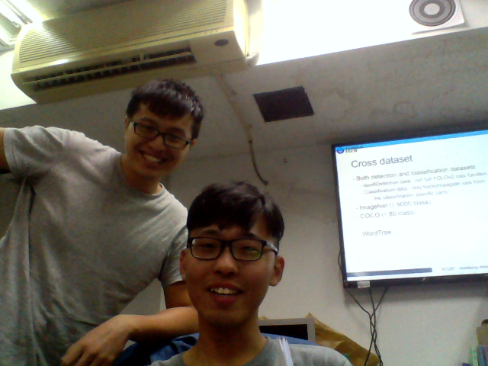
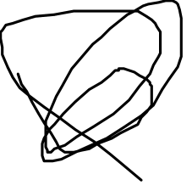
YOLO9000 gets 19.7 mAP overall with 16.0 mAP on the disjoint 156 object classes that it has never seen any labelled detection data for
Run at different resolutions for an easy tradeoff between speed and accuracy
Notes:
FPS is test on GTX Titan X

